Slide 1
1.2 (Day 1) Mean vs. Median, Box Plots, & Measuring Spread by Standard Deviation

Slide 2
Mean: A measure of the center; the “average value.”
Add the values of your observations and divide by the number of observations.
FORMULA: If the n observations are their mean is

Slide 3
Median: The median M is the midpoint “middle value” of a distribution. The number such that half the observations are smaller and the other half are larger. To find the median of a distribution:
1. Arrange all observations in order of size, from smallest to largest.
2. If the number of observations n is odd, the median M is the center observation in the ordered list.
3. If the number of observations n is even, the median M is the average of the two center observations in the ordered list.

Slide 4
Choices for center:
Mean or median or both
Note:
If the mean is greater than the median the data is skewed right
If the mean is less than the median the data is skewed left.
If the mean and median are the same the data is symmetric.
***The mean is pulled toward the tail in skewed distributions.

Slide 5
Describing the Spread:
If you use the mean for the center then use the standard deviation for the spread.
If you use the median for the center then use the IQR for the spread.
The other choices are the range, which is one number or the spread which is two numbers.

Slide 6
Given: Hank Aaron’s home run scores in his first 21 seasons
13 27 26 44 30 39 40 34 45 44 24 32 44 39 29 44 38 47 34 40 20
Find the Mean of the data.
Mean: 34.9
Find the Median of the data.
Median: 38

Slide 7
1.2 (Day 2) 5 Number Summary Worksheet:
Place your number on the board in order
(ascending order from left to right)

Slide 8
5 Number Summary
Arrange the observations in increasing order and locate the median M in the ordered list of observations.
The first quartile is the median of the observations whose position in the ordered list is to the left of the location of the overall median
The third Quartile is the median of the observations whose position in the ordered list is to the right of the overall median.
Lowest value is Minimum, highest is Maximum

Slide 9
5 Number Summary & Boxplots
consists of the smallest observation, the first quartile, the median, the third quartile, and the largest observation, written in order from smallest to largest
In symbols, the five number summary is
Minimum M Maximum
(Note: Read Boxplot box on bottom of pg 78)

Slide 10
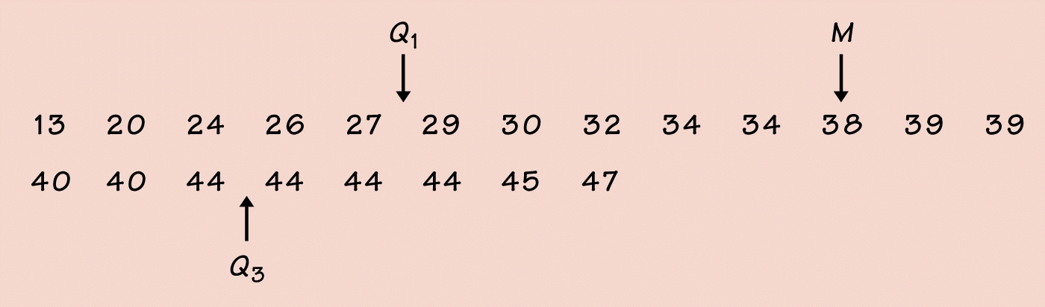
Find the Quartiles of Hank Aaron’s counts.
You can do it by hand:
Or you can use 1-VARIABLE STATS on the calculator:
Stat, Calc, 1-var stats, enter which list your put your data in

Slide 11
The interquartile range (IQR)
the distance between the first and third quartiles
Formula
IMPORTANT PROCESS FOR FINDING OUTLIERS!!!!!!!!!!!!!!: Call an observation an outlier if it falls more than 1.5 x IQR above the third quartile or below the first quartile

Slide 12
So, lets see if any of Hank Aaron’s counts are outliers
1st: Find
2nd: Find 1.5 x IQR
3rd: Find both: Q1 – 1.5(IQR) * Any data values below this are outliers
and Q3 + 1.5(IQR) * Any data values above this are outliers

Slide 13
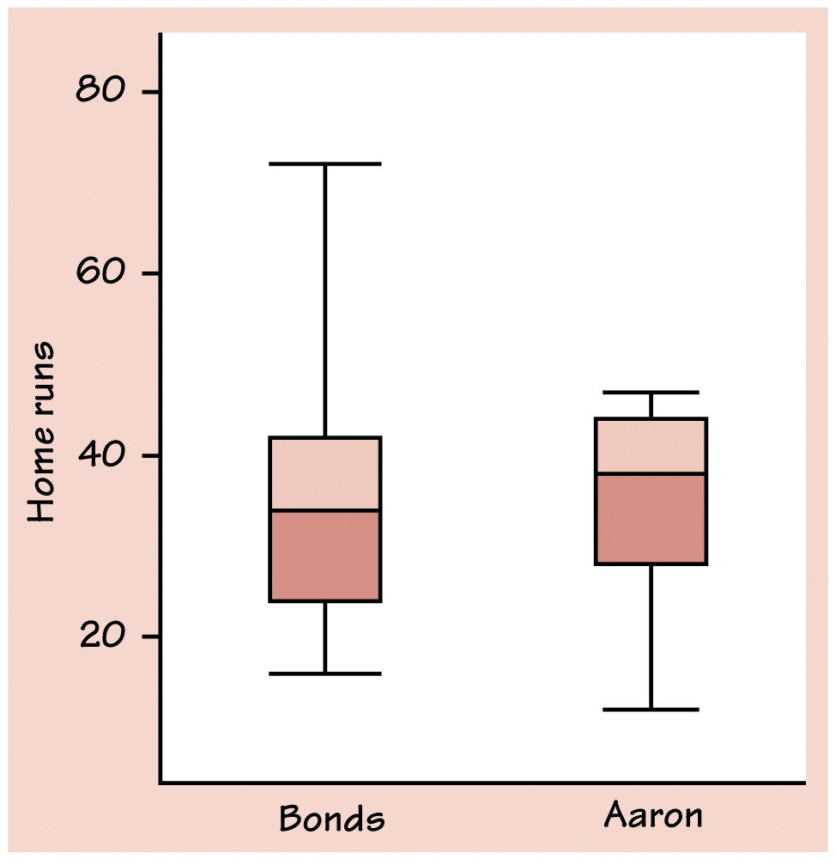
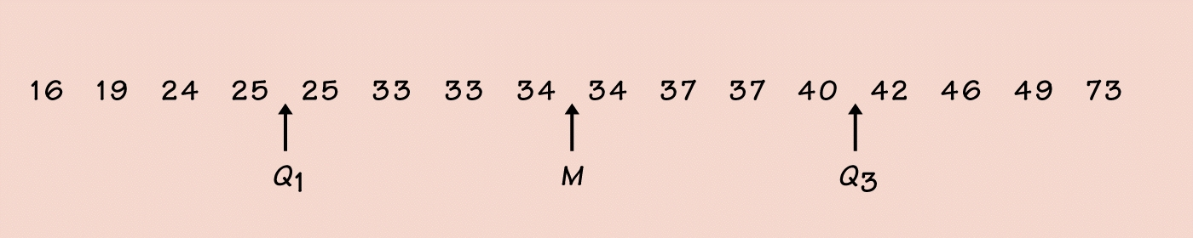
Barry Bonds Home Run Counts
Hank Aaron’s Home Run Counts

Slide 14
Modified Boxplots: Graphs of the five number summary with outliers plotted individually
A central box spans the quartiles
A line in the box marks the median
Observations more than 1.5 x IQR outside the central box are plotted individually
Lines extend from the box out to the smallest and largest observations that are not outliers

Slide 15
Variance
The variance of a set of observations is the average of the squares of the deviations of the observations from their mean.
FORMULA FOR VARIANCE:

Slide 16
Standard Deviation
The Standard deviation s is the square root of the variance
FORMULA for standard deviation is

Slide 17
Example: A person’s metabolic rate is the rate at which the body consumes energy. Here are the metabolic rates of 7 men who took part in a study of dieting.
1792 1666 1362 1614 1460 1867 1439
Calculate
1600
Calculate (variance)
35, 811.67
Calculate (standard deviation) s
189.24

Slide 18
Homework (1.3)
Finish Data Sets # 2 - 4 from the 5 Number summary worksheet
pg. 74 # 1.27(a & b), 1.28, 1.30
pg. 82 # 1.33, pg. 89 # 1.39

Slide 19
Properties of Standard Deviation
S measures the spread about the mean and should be used only when the mean is chosen as the measure of the center
S=0 only when there is no spread. This happens when all of the observations have the same value. Otherwise, s > 0. As the observations become more spread out about their mean, s gets larger
S, like is not resistant. Strong skewness or a few outliers can make s very large.

Slide 20
IMPORTANT: CHOOSING A SUMMARY
The five-number summary is usually better than the mean and standard deviation for describing a skewed distribution or a distribution with strong outliers.
Use standard deviation only for reasonably symmetric distributions that are free from outliers
ALWAYS PLOT YOUR DATA

